Slide 1
Network Intrusion Detection
Using Machine Learning
Team No. 2
Darshil Modi | Divya Mahajan | Sudhanva Suresh Aithal | Yu Ji

Slide 2
What is the problem ?
47% of businesses in the USA suffer from some kind of cyber attack.
Each cyber attack cost companies a median of 18000$ in 2022.
Average total cost of data breaches in 2022 was 4.35 million dollars.

Slide 3
What is at stake ?
A potential network attack can affect businesses in multiple ways.
It not only costs them money but also reputation and customers’ sensitive data.
Sometimes, customers' credit card credentials are stolen and sold on dark-webs by hackers.

Slide 4
Objective
Based on data features of a network packet, the goal is to predict whether an incoming network data packet is malicious or benign.
By analyzing nine labeled attacks with extracted features and the original network capture, we will detect anomalies in the incoming packet to detect network intrusion.
This prediction will help us identify a potential cyber-attack.

Slide 5
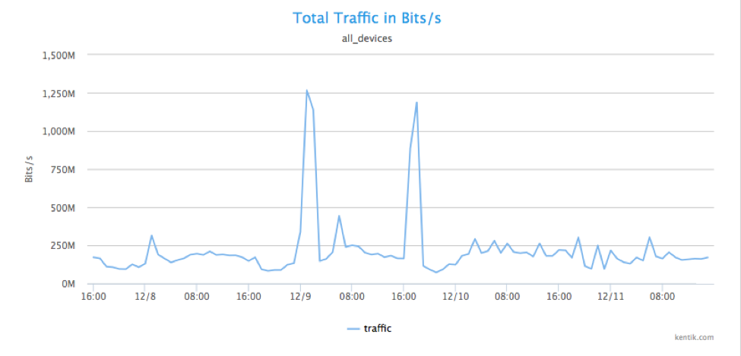
Traditional Approach
Security experts have been analysing network packets since a long time now
They used to put condition based security to restrict data breaches and network attacks.

Slide 6
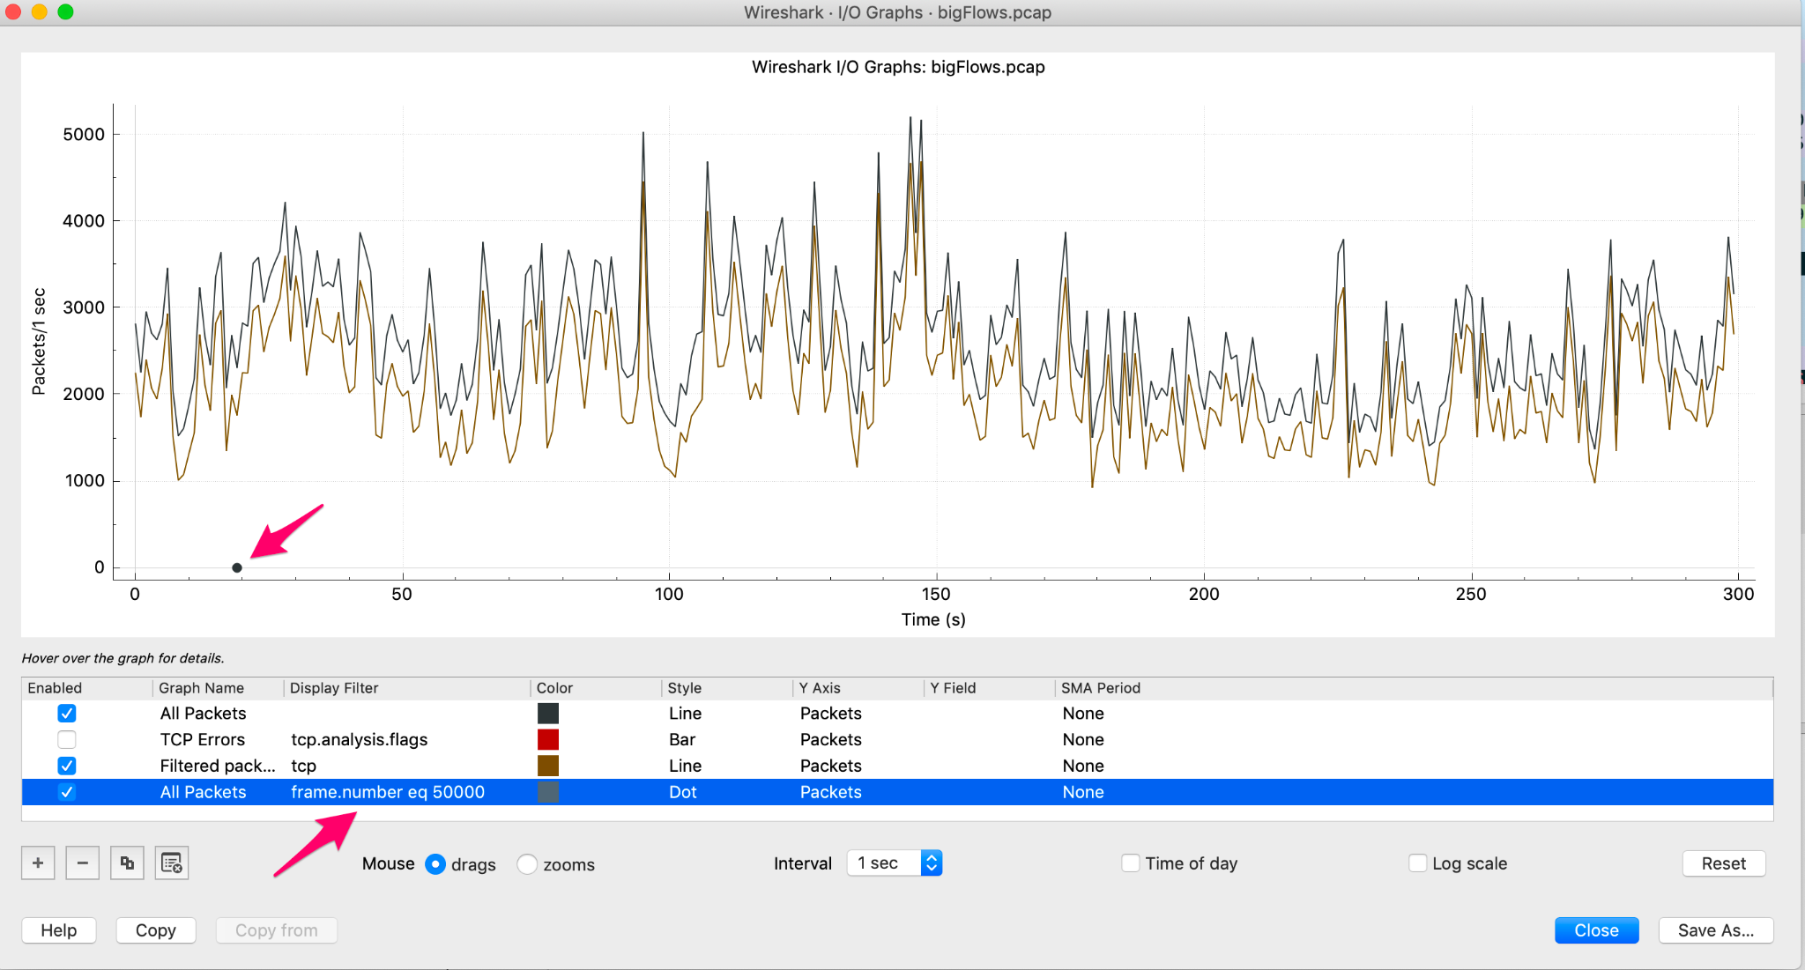
But what about this..

Slide 7
Why Machine Learning
Machine learning helps analyse complex patterns within the network packets to detect malicious attacks or intrusions.

Slide 8
Data preparation
-Our total data size was 55 GB ! [Kitsune Network Attack Dataset]
-So we loaded the data using pandas chunk-size module and performed Sampling to extract 1000 rows of benign and 1000 rows of malicious data points from each csv
-Further we added a column named attack and performed one hot encoding to label attacks ( 1 for MitM, 2 for Active wiretap, 3 for Fuzzing.. so on)

Slide 9
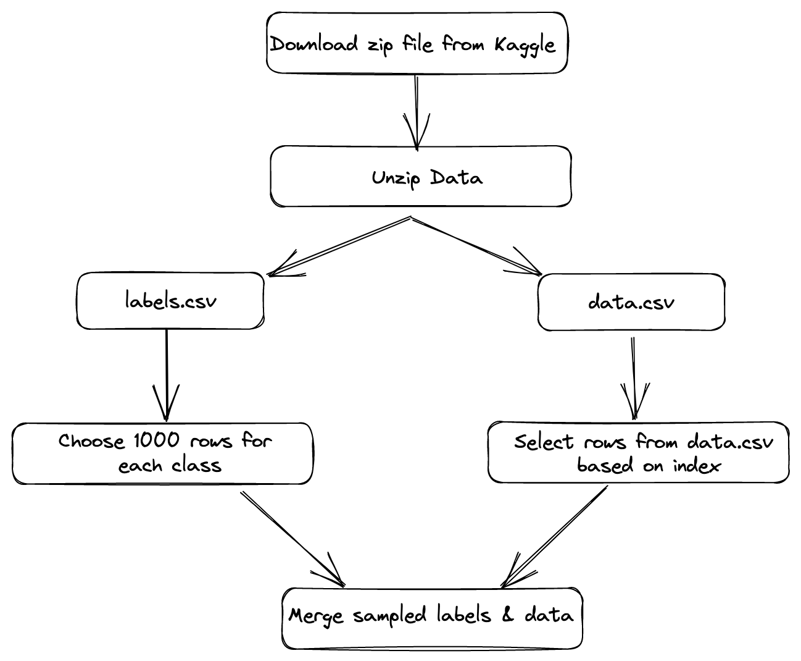
Sampling

Slide 10
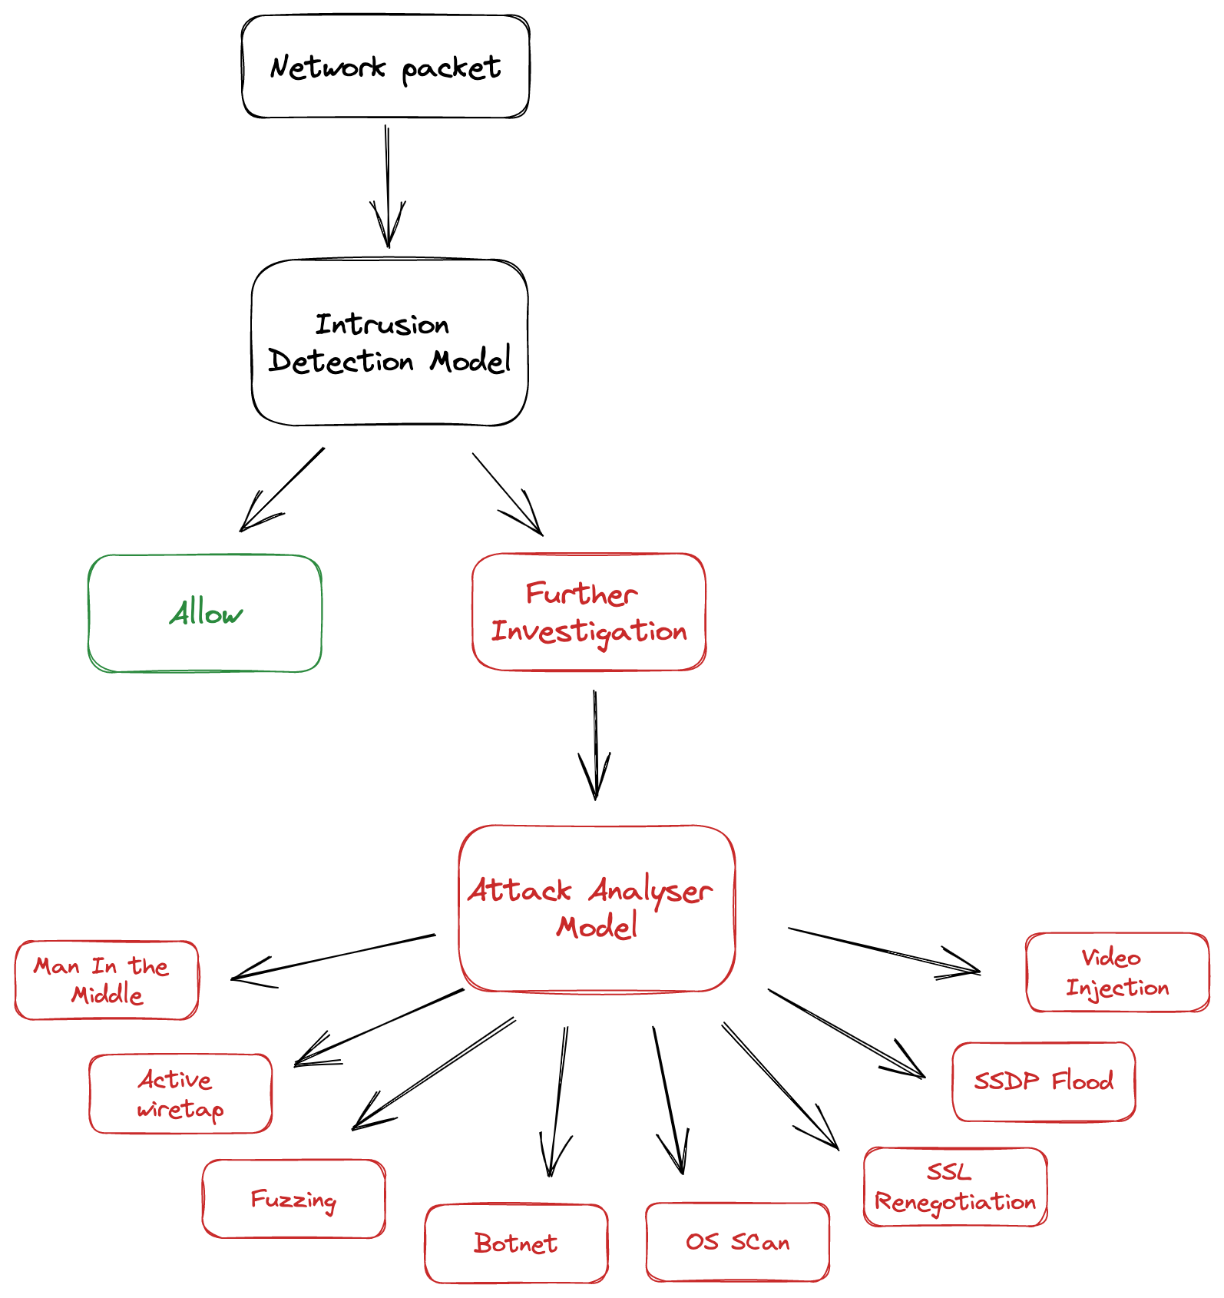
Stacked-Model
Approach

Slide 11
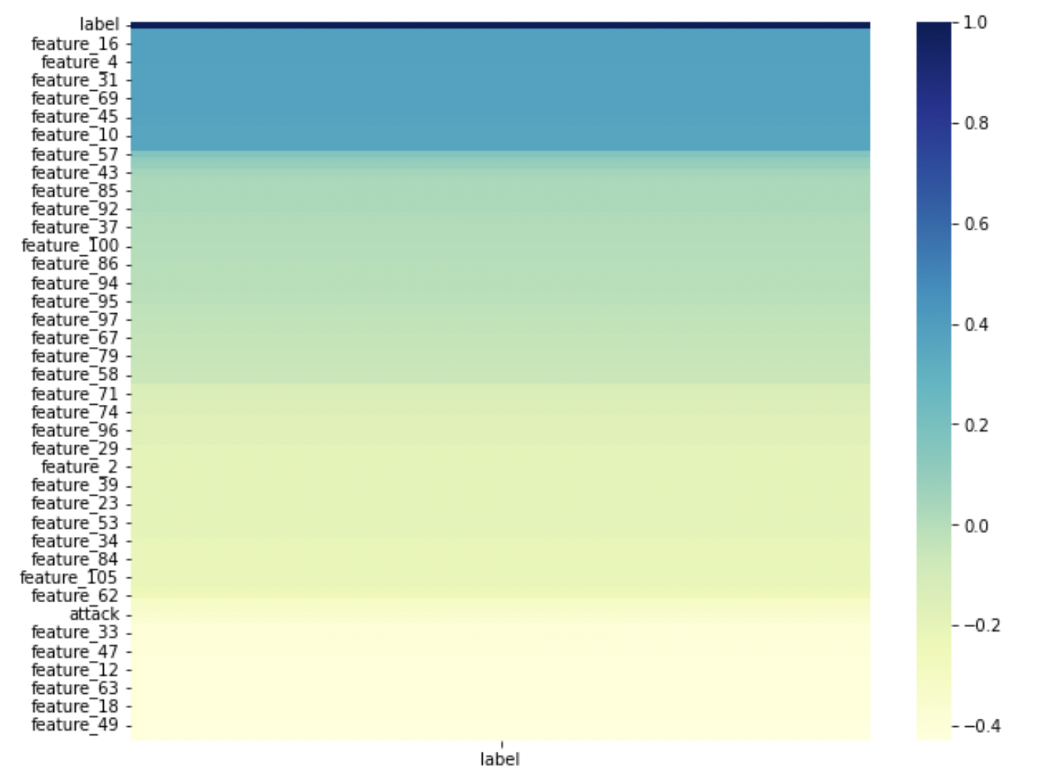
Feature selection
In order to select best features and reduce feature dimension, we analysed features using correlation heatmap.
Based on that we implemented selectKBest module from sklearn and selected best 50 features.

Slide 12
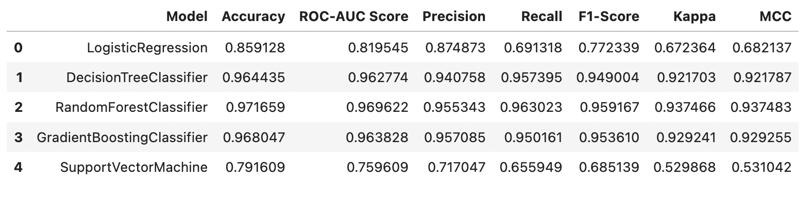
Intrusion Detection Model
This model takes network packet of length 115 features as an input.
This model is trained on two classes - Malicious / Benign
The training data including 9000 rows of Malicious and 9000 rows of Benign (1000 per attack)
So training data shape : 18000 x 115
Output

Slide 13
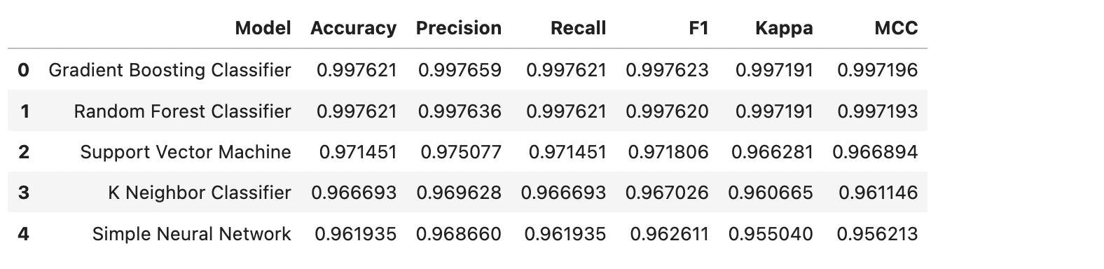
Attack analyser Model
This model takes only malicious network packets of length 115 features as an input.
This model is trained on nine attack classes - ARP Man-in-the-Middle, Active Wiretap, Fuzzing, OS Scan, SSDP Flood, Mirai Botnet, SSL Renegotiation, SYN DoS and Video Injection.
The training data includes 9000 rows of data (1000 per attack)
So training data shape : 9000 x 115
Output

Slide 14
Future scope & latest trends
Market leaders like sophos are implementing AI and ML models to detect malwares, malicious code scripts and even phishing emails using NLP techniques.
Since network packets are similar to time-series data, we can use complex models such as GRU or LSTM to better analyse network traffic and avoid network intrusions.
However with increasing use of AI and Generative models like ChatGPT, it has become easier than ever to create personalised phishing attacks which are more likely to be successful.
Who wins this age-old rivalry is a big question which only time can answer !

Slide 15
Thank You !
Questions ?

